Slide 1
RAM Memory Design
using Verilog
Jheel Makhijani

Slide 2
Index
Introduction
Single Port RAM
Verilog Code
Testbench
RTL Schematic
Output Waveform

Slide 3
RAM is used to store data temporarily.
It allows a computer to perform tasks like loading applications,browsing internet, viewing and editing files.
Here, the design of Single Port is done using Verilog.
Introduction To RAM

Slide 4
Single Port RAM

Slide 5
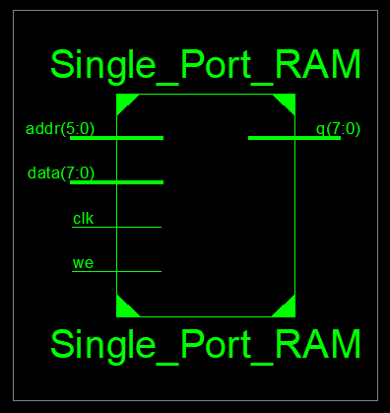
Single Port RAM performs sequential read-write operations.
That means,
Only one address can be accessed at a time.

Slide 6
Verilog Code of Single Port RAM
always @(posedge clk)
begin
if(we)
ram[addr] <= data;
else
addr_reg <= ram[addr];
end
assign q = ram[addr_reg];
endmodule
`timescale 1ns / 1ps
module Single_Port_RAM(data,addr,we,clk,q);
input [7:0]data;
input [5:0]addr;
input we, clk;
output [7:0]q;
reg [7:0] ram [63:0];
reg [5:0] addr_reg;

Slide 7
Testbench
data = 8'h02;
addr = 5'd1;
#10;
data = 8'h03;
addr = 5'd2;
#10;
addr = 5'd0;
we=1'b0;
#10;
addr=5'd1;
#10;
addr = 5'd2;
#10;
data = 8'h04;
addr = 5'd1;
we = 1'd1;
#10;
addr = 5'd2;
we = 1'b0;
#10;
#80 $finish;
end
endmodule
`timescale 1ns / 1ps
module RAM_tb;
reg [7:0] data;
reg [5:0] addr;
reg we, clk;
wire [7:0] q;
Single_Port_RAM uut (.data(data), .addr(addr), .we(we), .clk(clk), .q(q));
initial
begin
clk=1'b1;
forever #5 clk=~clk;
end
initial begin
data = 0; addr = 0; we = 0; clk = 0;
data = 8'h01;
addr = 5'd0;
we = 1'b1;
#10;

Slide 8
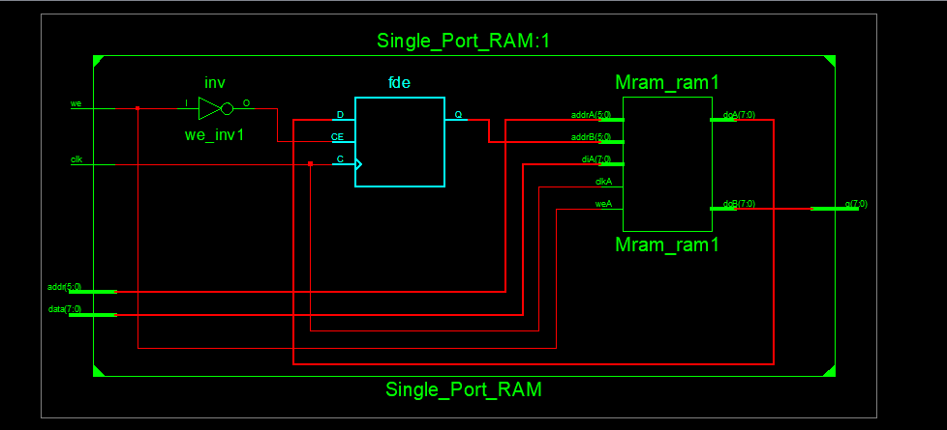

Slide 9
